Slide 1

Fábio Geiss Fucks
Spring AMQP

Slide 2
Spring AMQP
- AMQP: Advanced Message Queuing Protocol
Asynchronous and decoupled.
Services communicate by exchange messages.
Exists to break direct dependency between services.

Slide 3
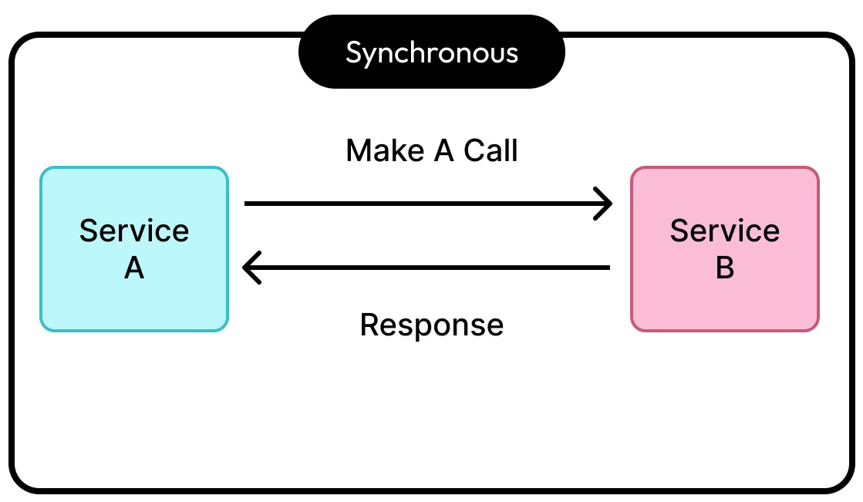
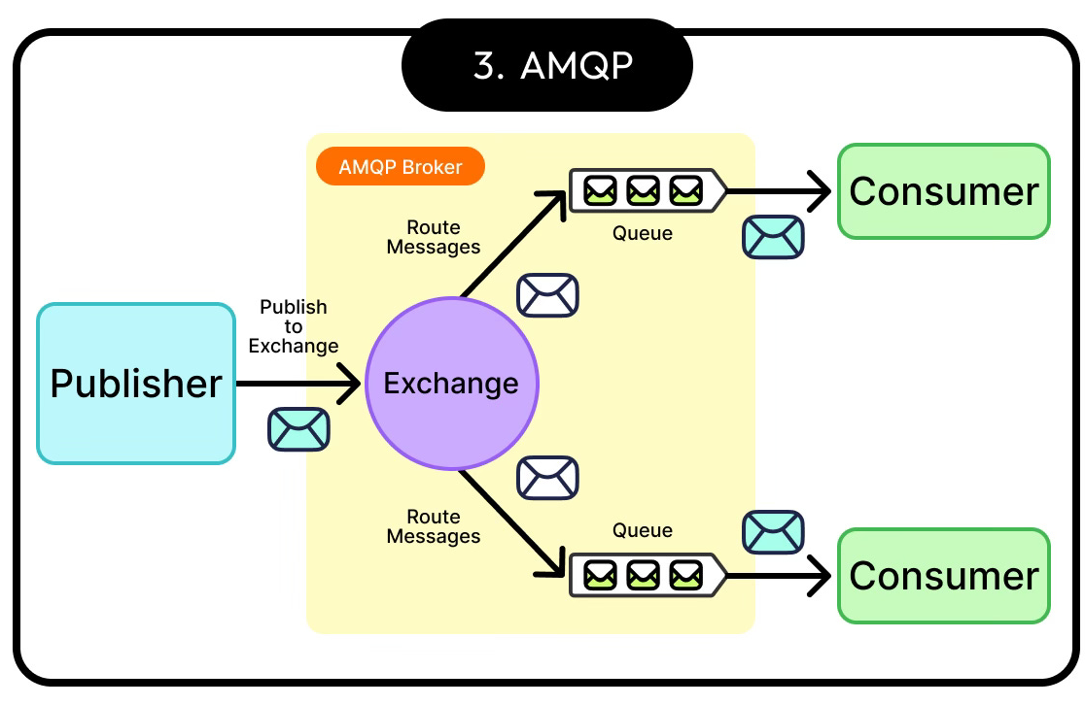
Spring AMQP

Slide 4
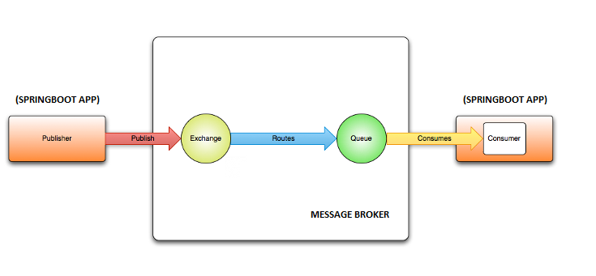
Spring AMQP
- Spring AMQP is a Spring framework that abstracts AMQP protocol.
Spring AMQP works without handling low-level broker details.
It solves the problem of reliable asynchronous communication.
RabbitMQ is the most used broker.

Slide 5
Spring AMQP
- JMS (Java Message Service)
API in Java.
Java ecosystem only.
Defines interfaces and contracts.
- AMQP
Messaging protocol.
Language Independent.
Defines message routing and delivery.
- Kafka
Messaging and streaming platform.
Stores message over time.
Suports message replay.

Slide 6
Spring AMQP
SHOW ME THE CODE

Slide 7
Spring AMQP
Positive:
- Simple integration with Spring.
- Mature and reliable consumption model.
- Decoupling between services.
Negative:
- Abstraction can hide perfomance problems.
- Broker dependency.

Slide 8

https://github.com/FFucks/spring-amqp

